Slide 1
New Trends and Developments in Estonian Cadastre
Tõnu Kägo
Quality department of Cadastre
PCC Conference and Plenary Meeting, Vienna 2018

Slide 2
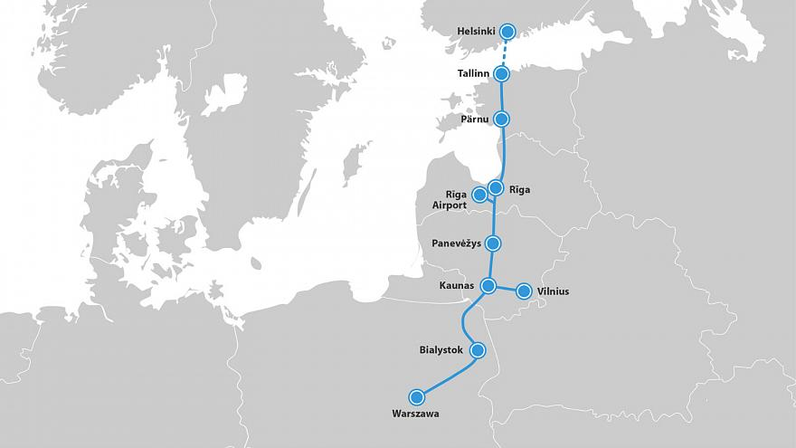
PCC, year ago in Tallinn…
Notes:
2

Slide 3
Legal umbrella for developments
Acquisition of Immovables in Public Interest Act (01.07.2018)
Land Cadastre Act (amendment 01.07.2018)
Land Consolidation Act (amendment 01.07.2018)
The Procedure for the Formation of Cadastral Parcel (14.08.2018)
Spatial Data Act (amendment 01.07.2018)
Law of Property Act (amendment 01.07.2018)
Notes:
3

Slide 4
Current situation
The objective of the maintenance of the cadastre is to register and preserve land information in order to provide the public with up-to-date basic data about land.
boundary and spatial extent of immovable
land value
natural status of land
information on land use

Slide 5
Current situation
65% of land is registered in Cadastre before GIS era
99,0% of Estona is registered in Cadastre (October 2018)
Paper map
Digital data
GIS era
Digital signature
Notes:
5

Slide 6
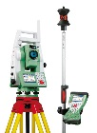
Only half of the 704 747 parcels have accurate boundaries!
Current situation
Number of cadastral parcels
Area of cadastral parcels
4 methods of cadastral parcel formation (the way of cadastral survey) was allowed during the land reform.
Notes:
6

Slide 7
Boundary and spatial extent of immovable
New principle - there may be several notations concerning the parcel in the Cadastre. Notations are entered into the Land Register (Title Book) as well. Notations are made public!
„Necessity to determine property boundary”
„Area is inaccurate”
when the parcel is formed in general boundaries (pen+map method), or when the cadastral registrar identifies inaccurate or contradictory boundary data
when the boundary data of adjoining parcels are contradictory, or when the location of boundary points in nature does not coincide with the boundary data entered into the cadastre

Slide 8
New principle – cadastral registrar has right to form cadastral parcel
Boundary and spatial extent of immovable
Owner of immovable
Applies for terms of parcel formation
Cadastral registrar
May join or divide parcels
Land surveyor
Demarcates and surveys the boundary
Must introduce the boundary to the involved owners
May allow partial surveying
Informs ETD of inaccuracies in nature
Decides on the extent of survey and form of data submission
Informs cadastral registrar of inaccuracies concerning restrictions
Must determine the boundary in the case of contradictory data
Cadastral registrar
Forms the cadastral parcel, determines the area, land use/cover and registers the parcel

Slide 9
New principle - Correction of cadastral data. The list of possibilities is much longer now.
Boundary and spatial extent of immovable
The cadastral registrar has the right to correct cadastral data on the basis of cadastral surveys.
The cadastral registrar has the right to correct cadastral data without a cadastral survey if the following has been established:
1) more exact base data of the boundaries and location;
2) variation from the geodetic network or backdrop map;
3) a conversion mistake
4) an error in making the cadastral entry.
the owner of the immovable shall not be involved provided that the boundary of the cadastral unit in the field is not subject to change.

Slide 10
From two layer → one layer
Boundary and spatial extent of immovable
New principle – boundary points of different parcels will be aligned
Donaustraße 21
2000m²
Donaustraße 23
2000m²
Donaustraße 25
2000m²
Donaustraße 27
2000m²

Slide 11
From two layer → one layer
Boundary and spatial extent of immovable
New principle – boundary points of different parcels will be aligned
Donaustraße 21
2001m²
Donaustraße 23
2000m²
Donaustraße 25
1998m²
Donaustraße 27
2001m²

Slide 12
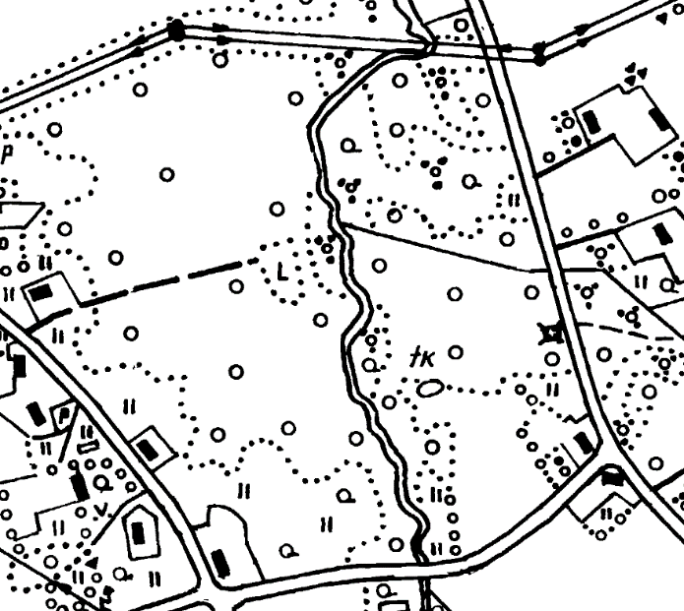
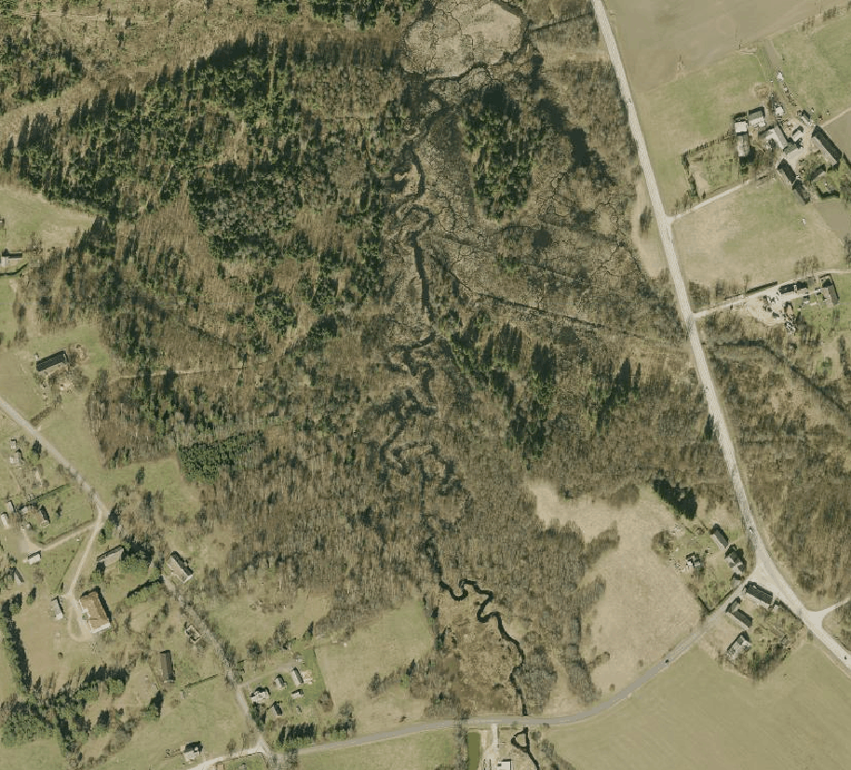
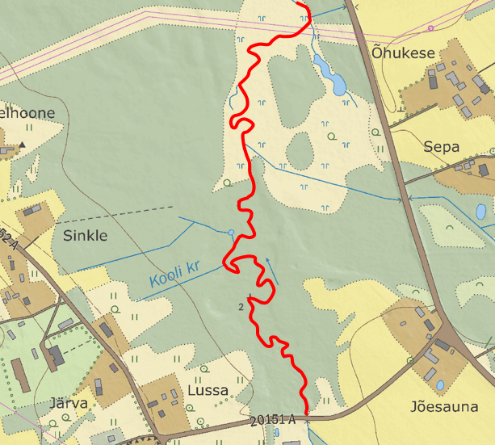
Boundary and spatial extent of immovable
New principle – some boundaries in the cadastral map will be matched with ETD (Estonian Topographic Database)

Slide 13
Example 1: The cadastral registrar decides which boundary points will be surveyed
Boundary and spatial extent of immovable

Slide 14
Example 2: The cadastral registrar may divide cadastral parcels electronically, provided that suitable base data are available
Boundary and spatial extent of immovable

Slide 15
Boundary and spatial extent of immovable
Example 3: The cadastral registrar may carry out land consolidation electronically, provided there is no need to determine a new boundary point in the field.

Slide 16
Natural status of land
New principle – topographic database integrated to cadastre
The map of land use/cover types is compiled based on the Estonian Topographic Database (ETD)
The map of land use/cover types contains the following land use types: arable land, natural grassland, forest land, yard land and other land.
Cadastral boundary data will be linked to topographic data to track the changes
The areas of land use/cover types for every parcel will be calculated once a year

Slide 17
Impact of changes in shape areas + changes in land use/cover types
Land value
The area of 7287 of cadastral parcels will change more than10%
The area of 15938 of cadastral parcels will change 5-10%
The area of 65657 cadastral parcels will change 1,1-5%
Arable land -3 526 ha Yard land +13 716 ha
Natural grassland +59 464 ha Other land +7 021 ha
Forest land +60 579 ha
The assessed value will increase over 1000 euros for 148 cadastral parcels
The assessed value will decrease over 1000 euros for 135 cadastral parcels
The assessed value will increase over 100 euros for 8948 cadastral parcels
The assessed value will decrease over 100 euros for 7258 cadastral parcels

Slide 18
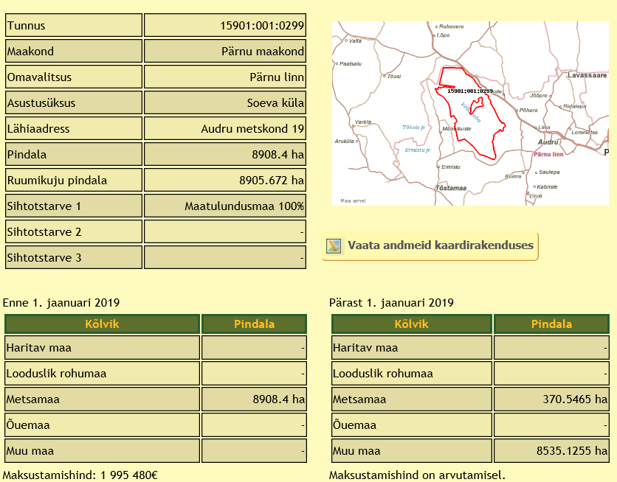
Query of land use/cover types of the parcel in Geoportal
Land value
Legal area
Shape area
Beffore 01.01.2019
After 01.01.2019
Forest land
Forest land
Other land
Other land

Slide 19
Information on land use
New principle – Payments for tolerating utility networks starting from 01.01.2019
In order to be compensated for tolerating utility networks, the land owner will submit a request via Geoportal to the owner of utility network.
The annual payment for tolerating utility networks is 7,5 % of the assessed value of land x coefficients of the restriction.
Assessed values of land are calculated by the Land Board
In total, there are data on 440 999 cadastral parcels available
Public application in Geoportal

Slide 20
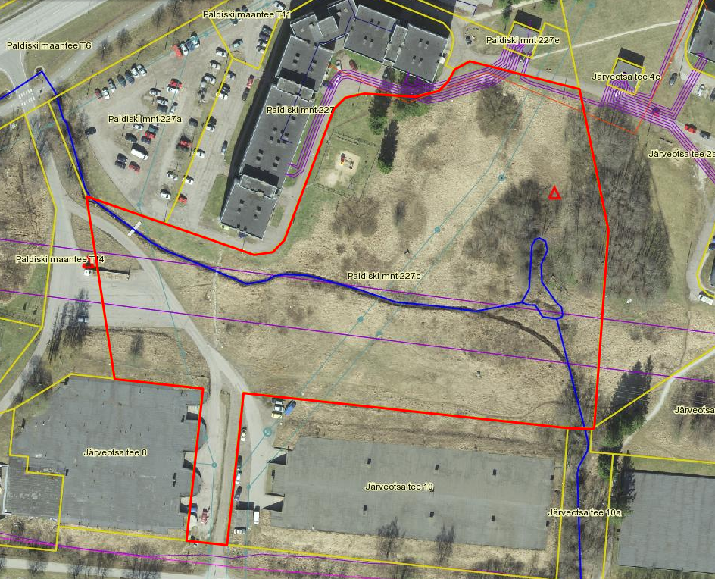
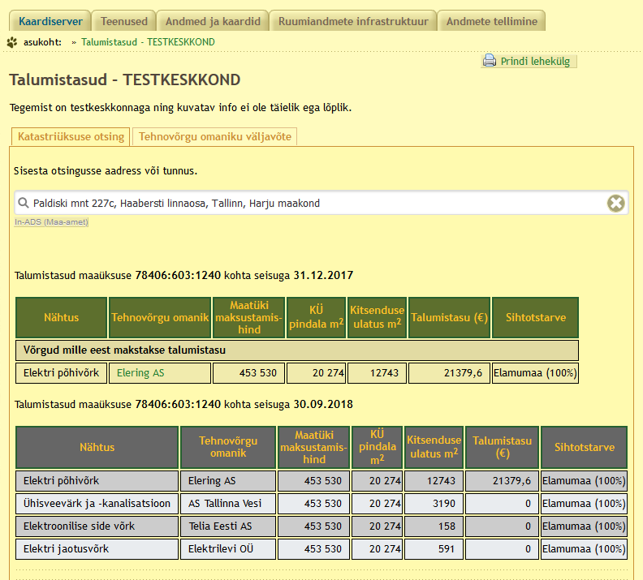
Information on land use
Public application in Geoportal

Slide 21
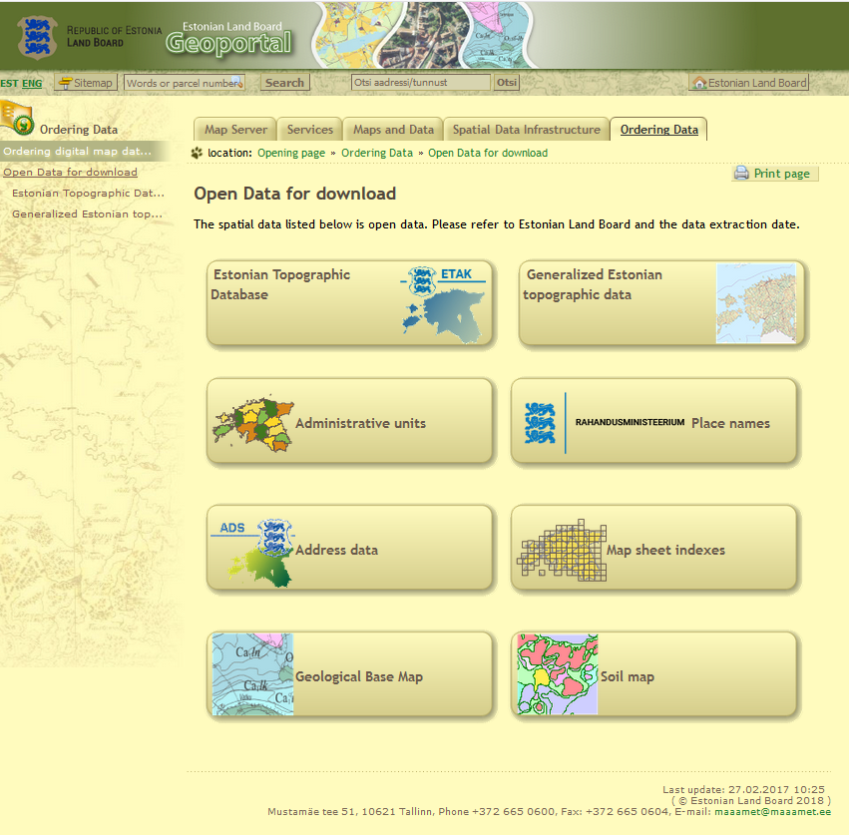
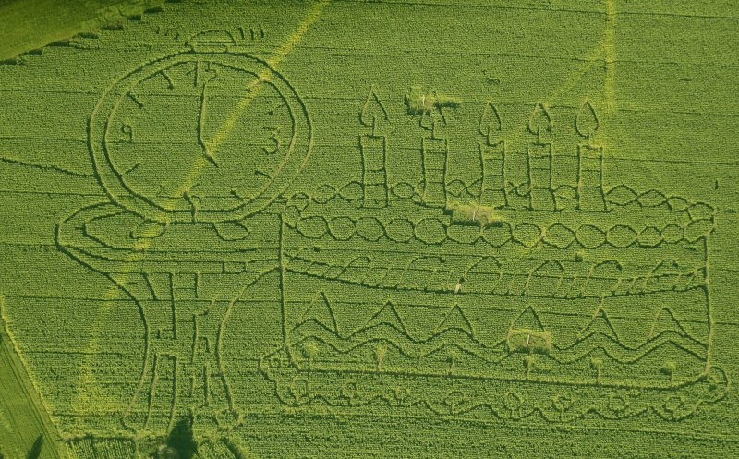
Open data since 01.07.2018
Cadastral parcel data
Assessed values
Areas of restrictions (areas of influence)
Core data from ETD, Thematic datasets for entire Estonia (buildings, transportation etc.)
Basic Map 1:10K in raster and vector format, 1:20K, 1:50K, 1:250K.
Soil Map
Geological Base Map
Orthophotos since 2002 (RGB, False-color CIR, False-color forestry NRG, densely populated urban areas)
Elevation Data (Raw LiDAR data, Digital Terrain Model, Digital Surface Model, Canopy Height Model, Shaded relief imagery

Slide 22
Challenges for future
Development from registration of cadastral parcels to the environment of land procedures, which allows an easy, quick and cheap performance of land management increasing thus the turnover in the property market.
Land consolidation module development in e-Cadastre workbench.
Approvals module (for different authorities) development in e-Cadastre workbench.
Visualization of all kind of restricted real rights (servitudes, encumbrances) having spatial extent.
From July 2020 only physical person can be cadastral surveyor.
Ongoing communication.
Notes:
22

Slide 23
Summary
New cadastral concept (for Estonia?), the aim of which is to update cadastral data
Some of boundaries in the cadastral map will be matched with ETD
Boundary points of different parcels will be aligned
Natural status of parcel (land use/cover types) will be identified from ETD on regular bases
The boundary in nature does not change.
All changes are made in order to update the register

Slide 24
Thank you for attention
Tõnu Kägo
Quality Department of Cadastre
Tonu.Kago@maaamet.ee
Paper-fre communiction with the Cadastre
Notes:
24

